Slide 1



Instacart Grocery Basket Analysis

Slide 2
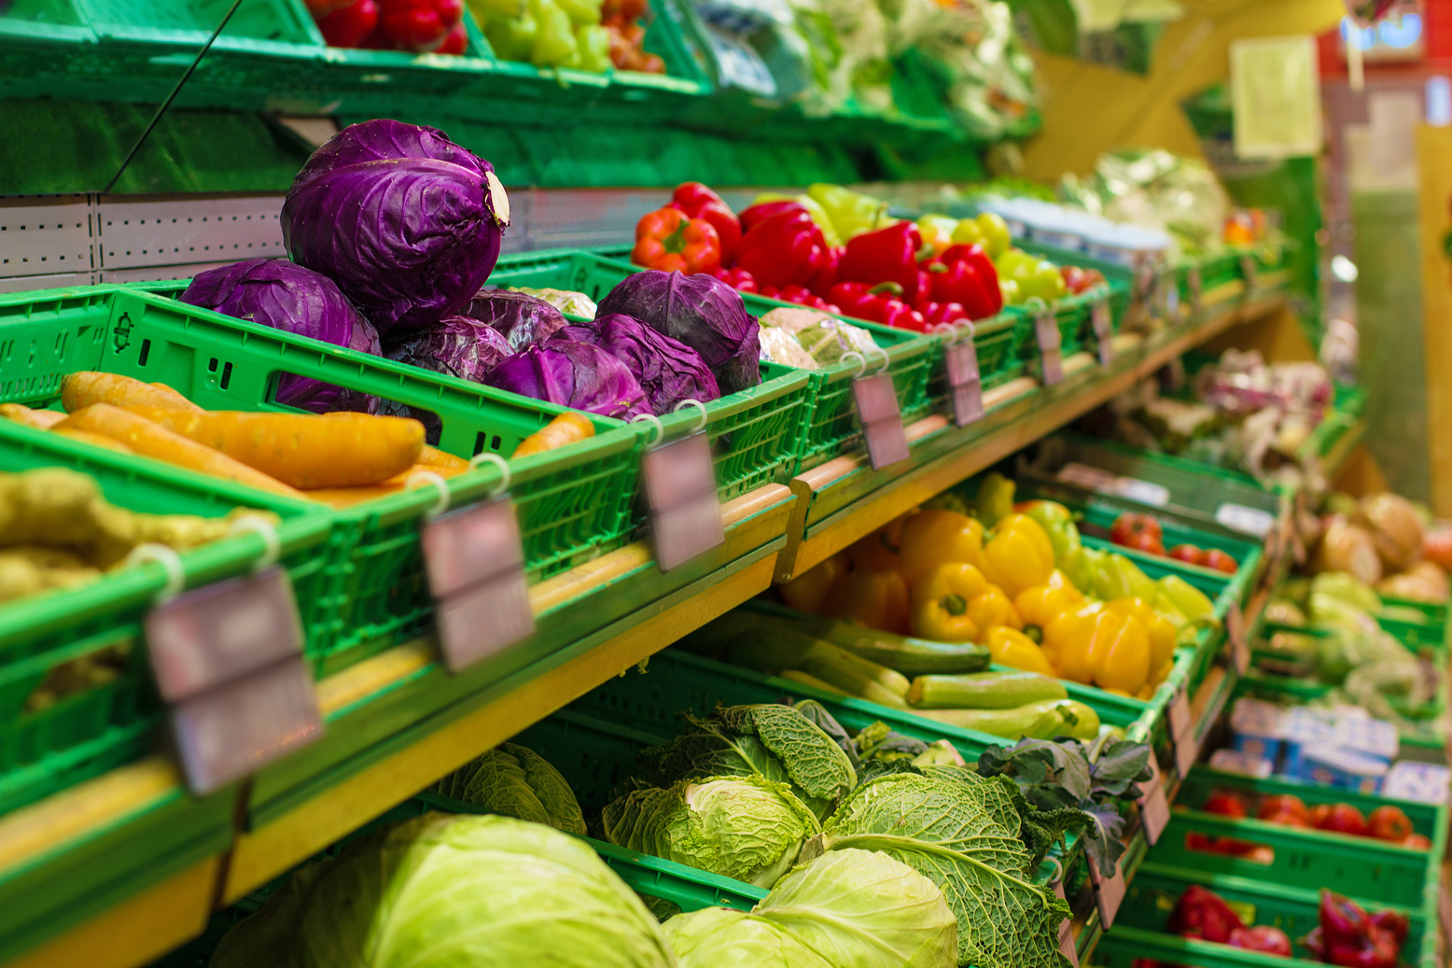
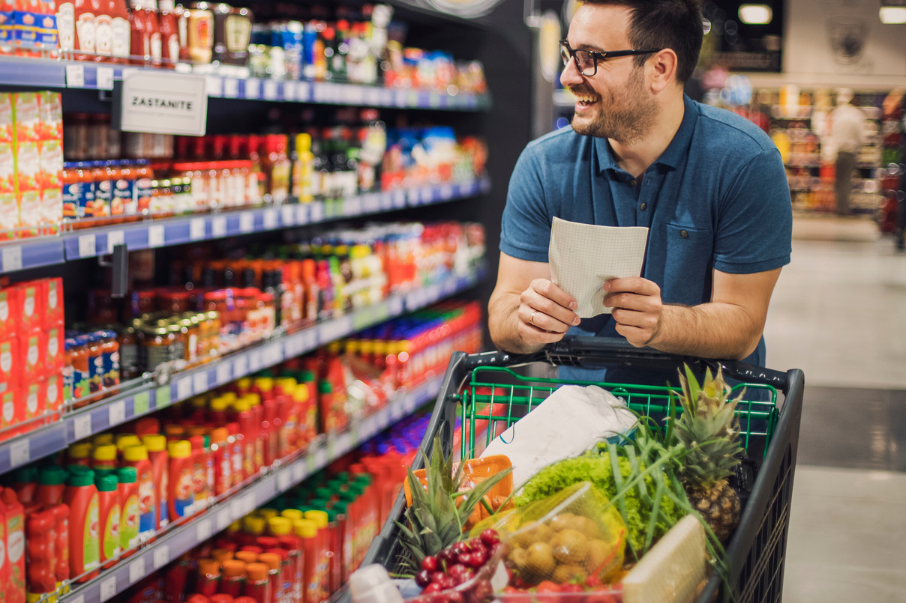
Introduction
Instacart is an online grocery store that functions through a mobile app. While already achieving impressive sales, Instacart aims to gain deeper insights into their sales trends.
Motivation
The Instacart stakeholders focus on customer variety and behaviors for targeted marketing strategies. They aim to tailor campaigns to different customer profiles for increased product sales, seeking insights to refine their approach.
Data Limitations
Data Set was created for learning purposes and some information is limited.

Slide 3



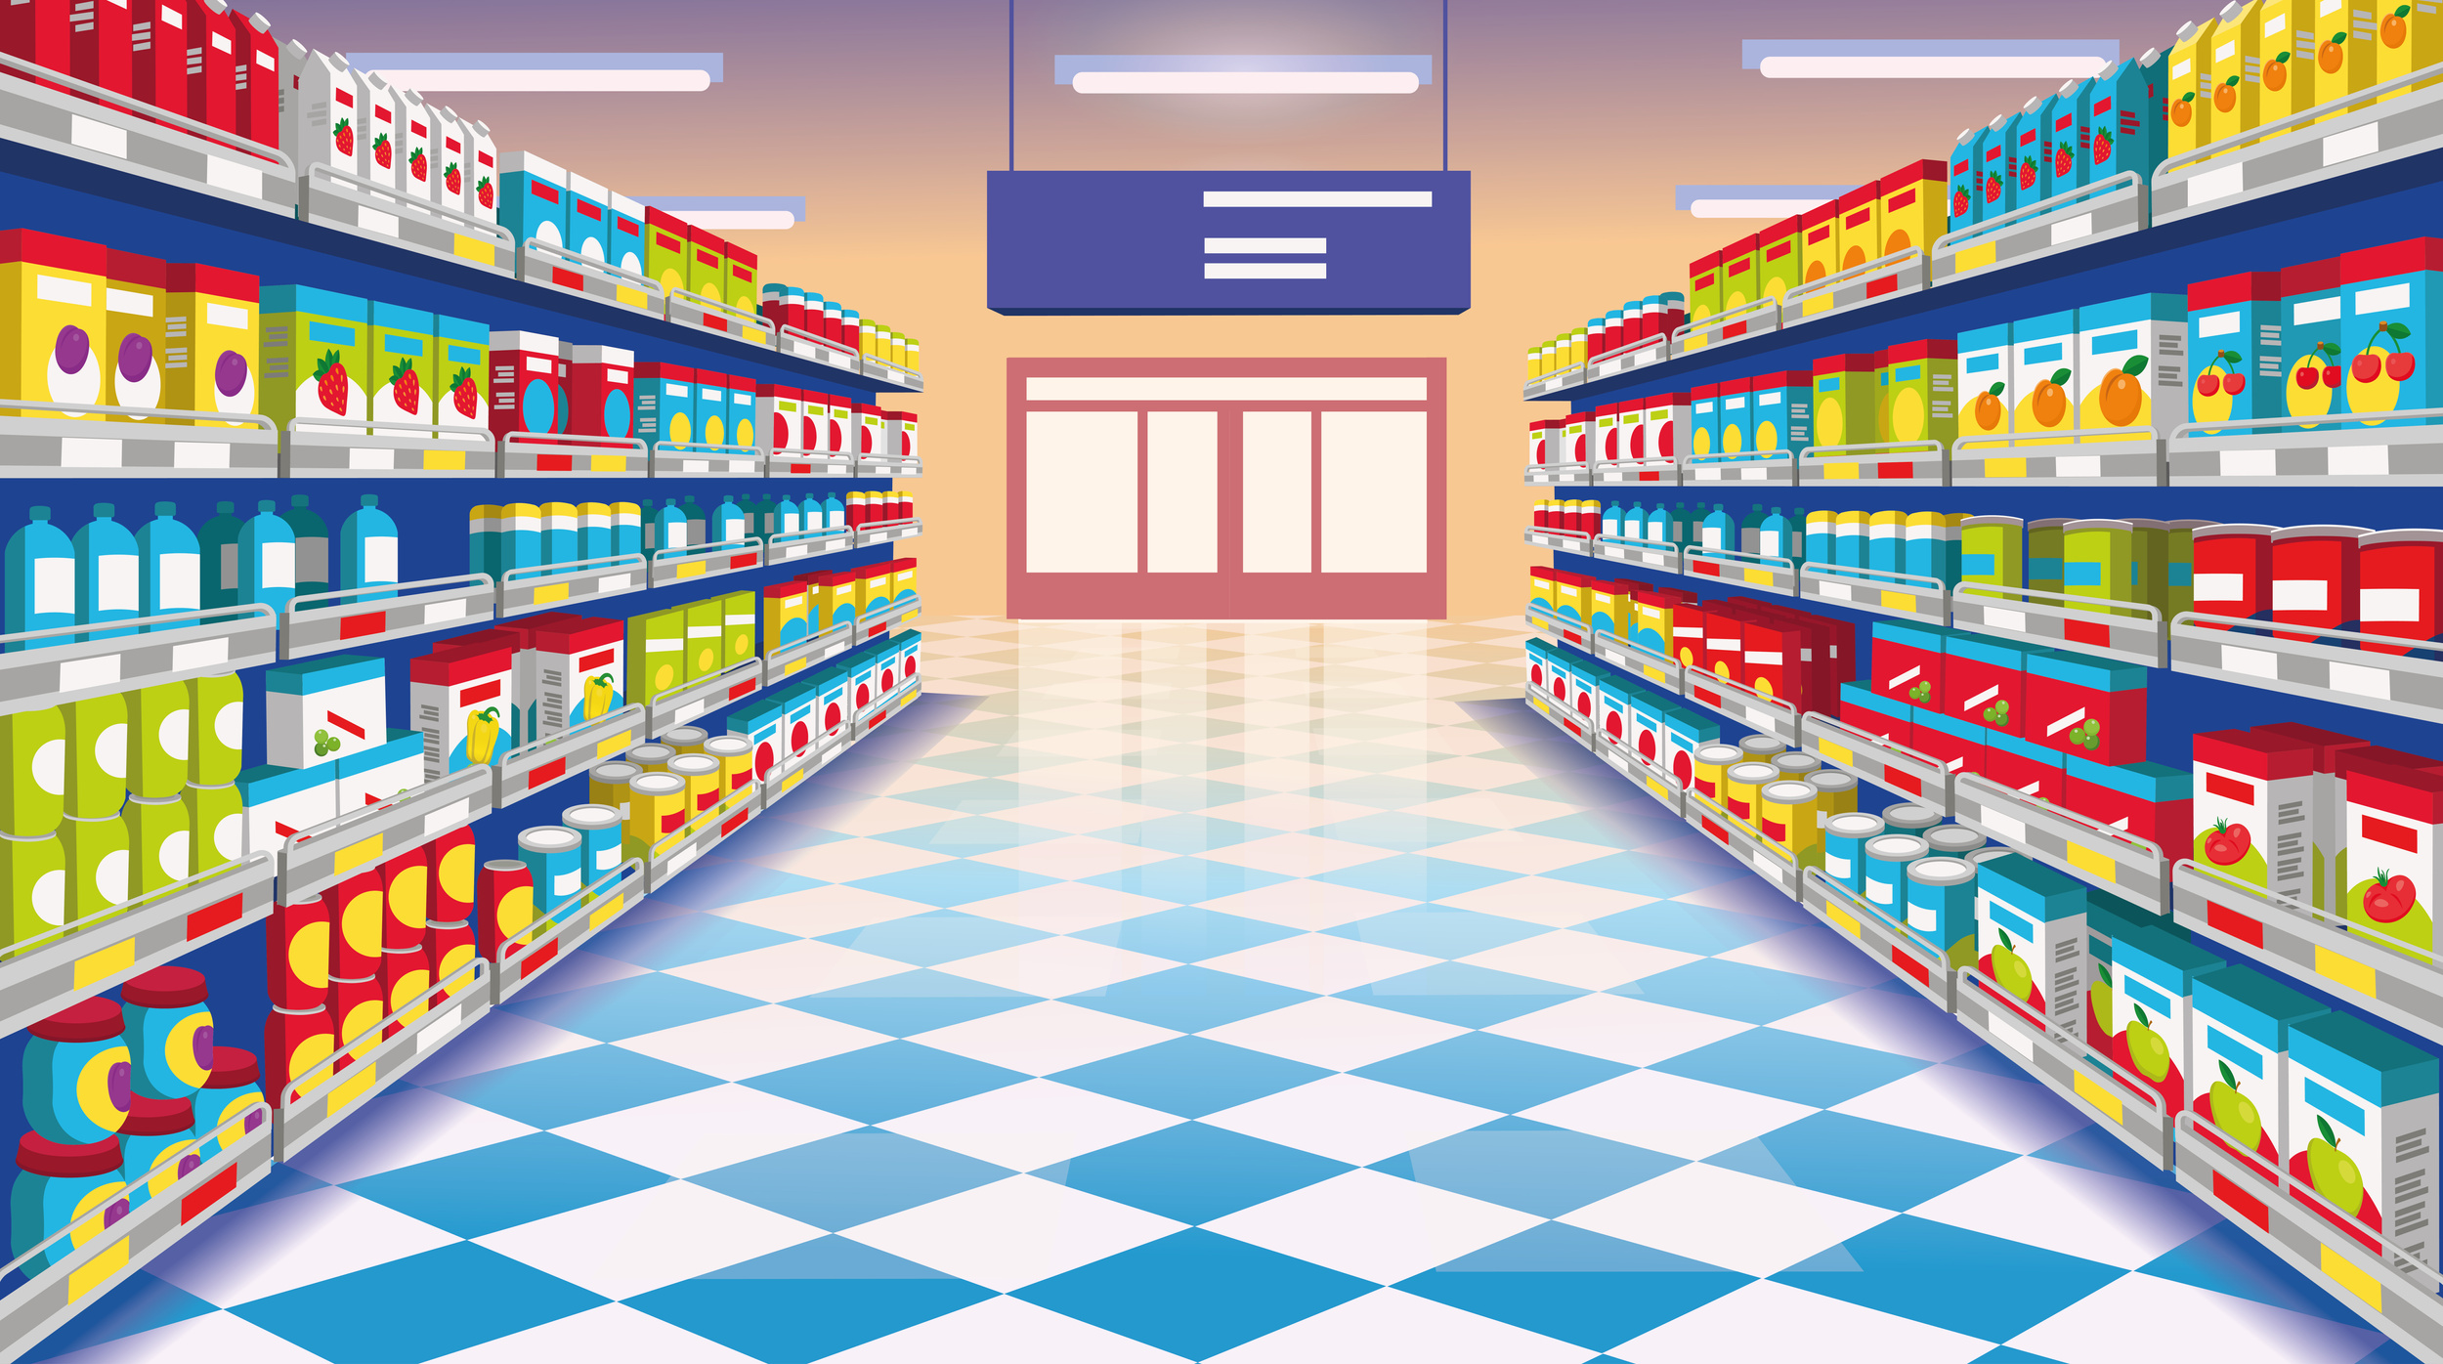
Data Overview
Orders
Dataset provides a summary of orders made through Instacart, an online grocery store.
Products
Contains information about the products available on Instacart.
Departments
Dataset provides information about the different departments within Instacart's product offerings.

Slide 4
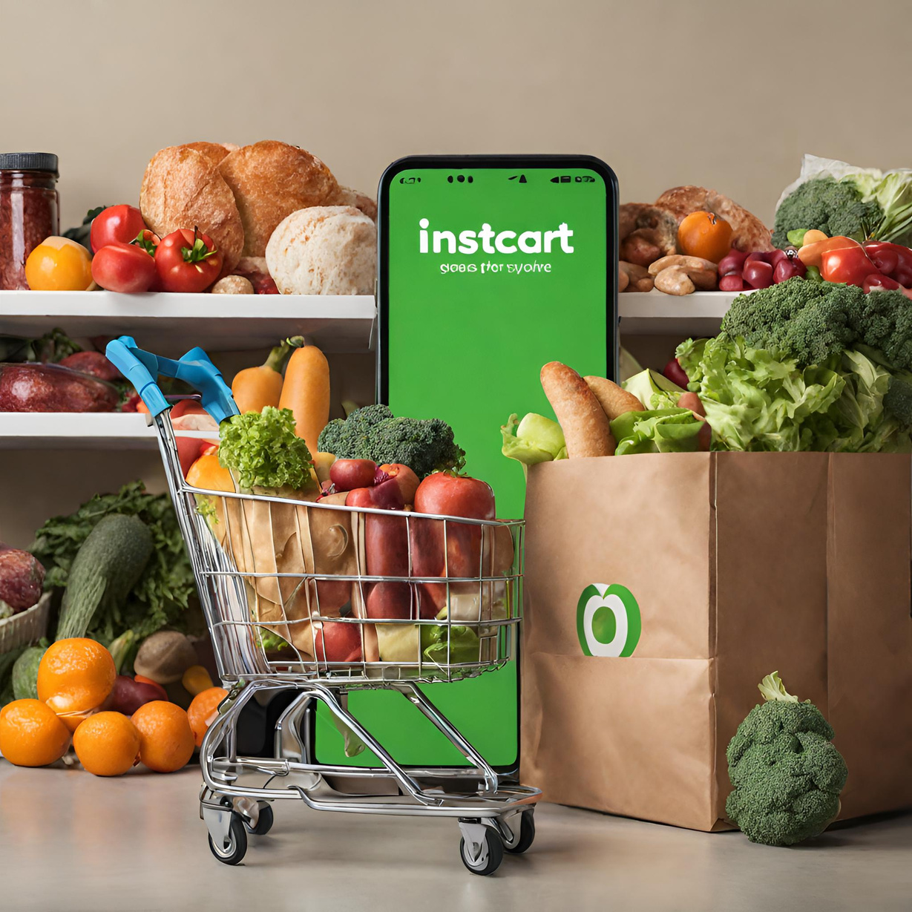





Objectives
Regional Market Analysis
Tools Used :
Understand Customer Behavior
Data-Driven Recommendations

Slide 5
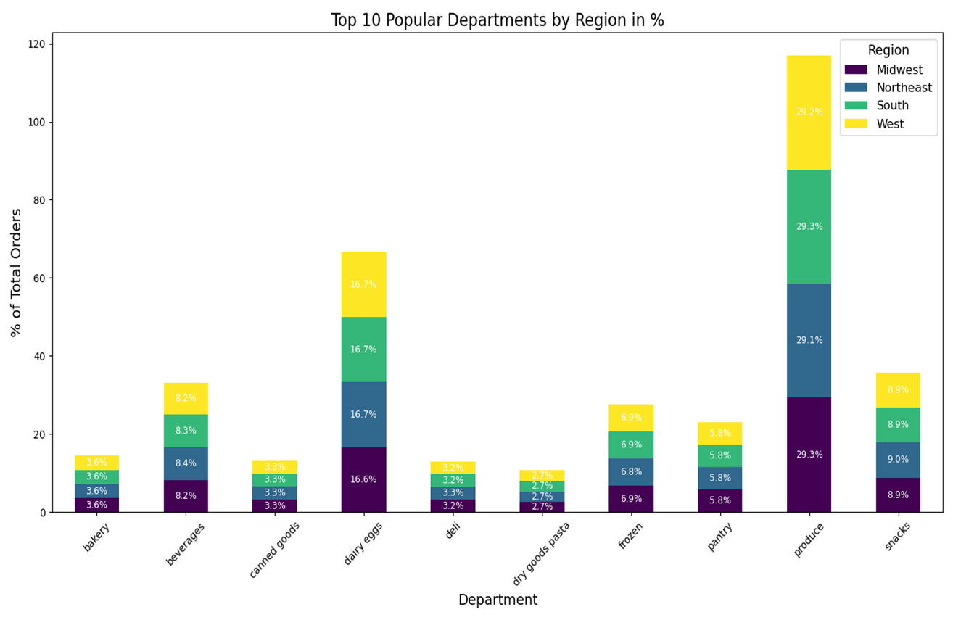
What are the Top 10 Most Popular Departments by Region?
Produce dominates in every region, making up around 29% of total orders, highlighting its importance as a staple department.
Snacks and dairy & eggs are also significant contributors to the overall order count across all regions.
Bakeries are more popular in the South, whereas frozen items have a slightly higher percentage in the West compared to other regions. Beverages and canned goods maintain a consistent share of orders across all regions.

Slide 6
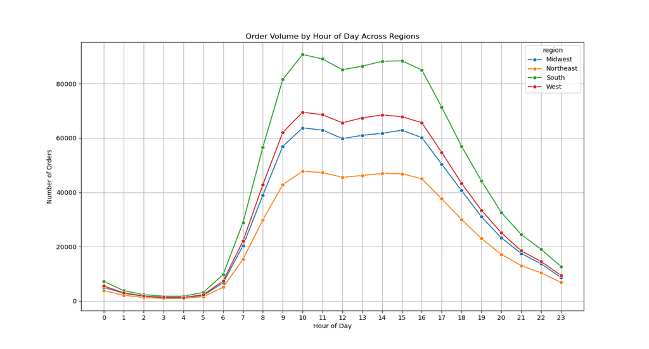
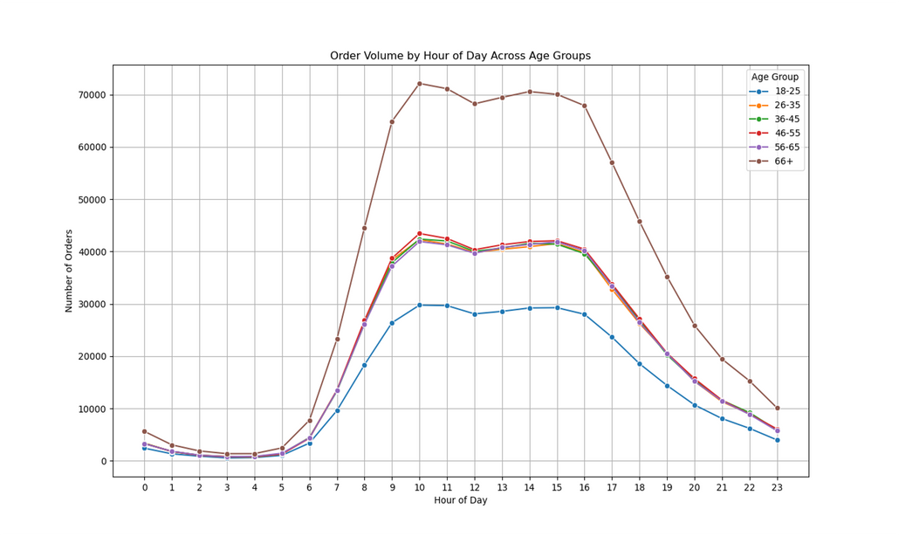
What is the order volume by hour across regions?
What is the volume by hour of the day across age groups?
A consistent pattern is observed across all regions, with a sharp rise in the morning, a plateau around midday, and a decrease in the evening. Notably, the South region consistently records the highest volume of orders, while the West region consistently has the lowest.
Across all age groups, a consistent pattern emerges, with order volumes rising significantly in the morning, reaching a peak around noon, and then decreasing in the evening. Notably, the oldest age group, 66+, exhibits an earlier peak and a decline that starts earlier in the day compared to the other age groups.

Slide 7
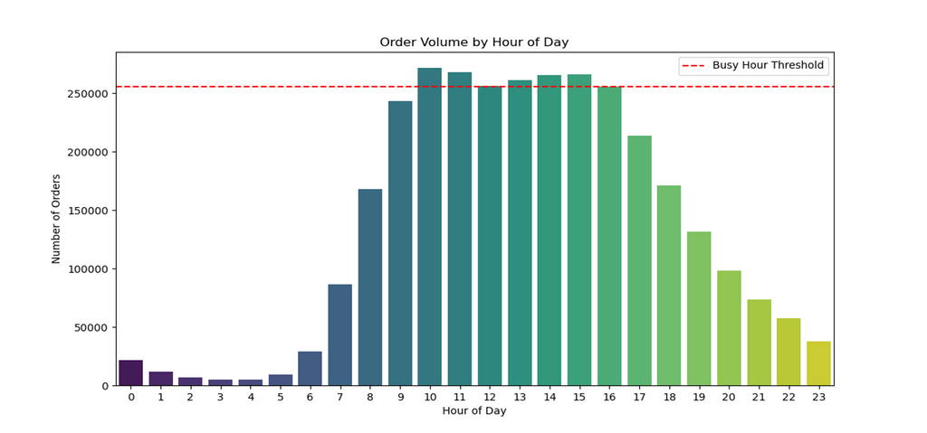

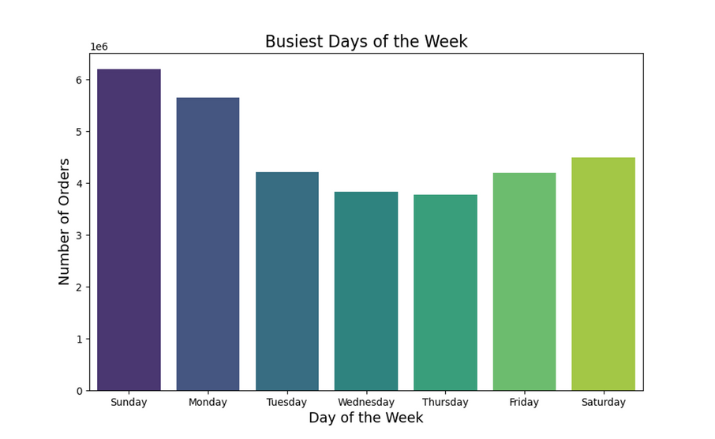
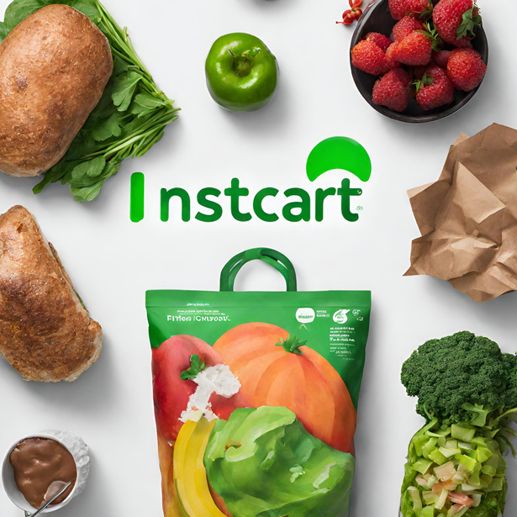
What time of the day people spend most of their money?
The hours from late morning to early evening (around 10 AM to
4 PM) are the busiest, with the order volume consistently exceeding the busy hour threshold. The least number of orders are placed in the early morning hours (12 AM to 6 AM).
The South region has the highest number of both high and low spenders, while the Northeast has the lowest.

Slide 8
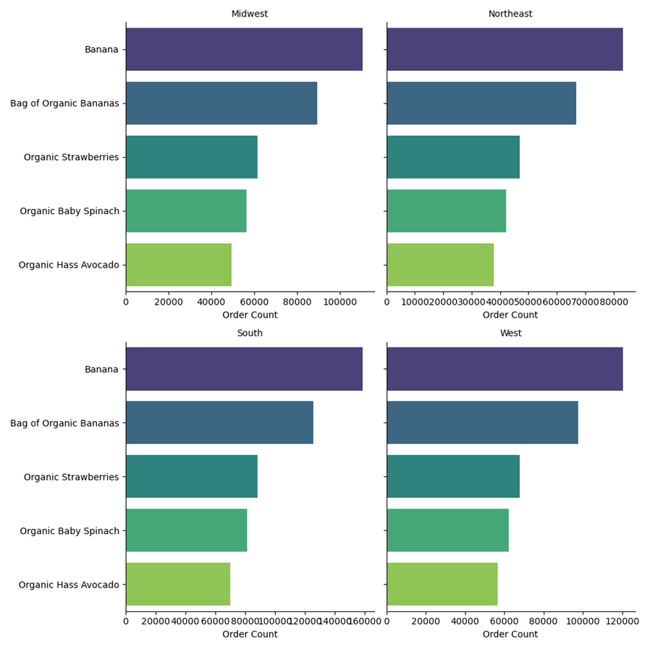




What products are the most popular across regions?
Bananas and organic bananas are consistently the top two most popular items in all regions, with bananas being the most frequently ordered item. This ongoing trend indicates that these products may be essential purchases for many customers in these areas.
For the Midwest and Northeast, organic strawberries, organic baby spinach, and organic Hass avocados follow as the next most popular items, whereas in the South and West, organic strawberries rank third, with organic baby spinach and organic Hass avocados also making it into the top five.
Most popular products across regionst

Slide 9
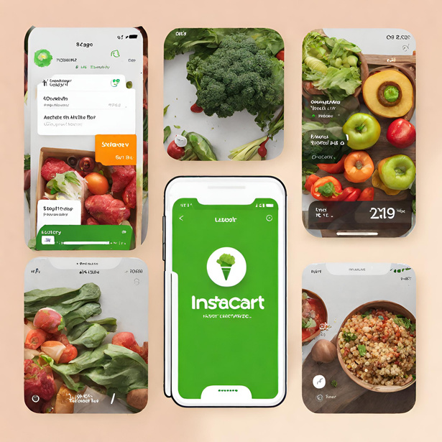
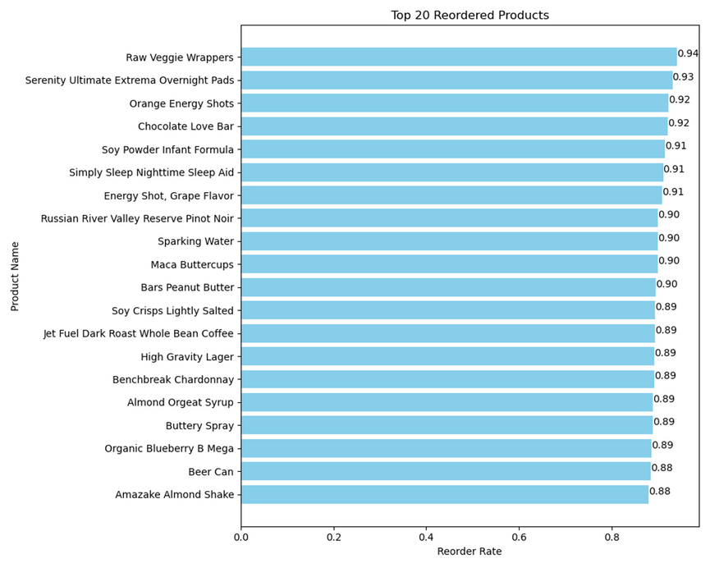

What are the Top 20 most reordered products?
Products like "Raw Veggie Wrappers" and "Serenity Ultimate Extrema Overnight Pads" have reorder rates around 94% and 93%, indicating high customer loyalty or product dependence.
Energy-related items like "Orange Energy Shots" and "Energy Shot, Grape Flavor" also feature prominently, which might indicate a customer preference for quick energy boosts.

Slide 10
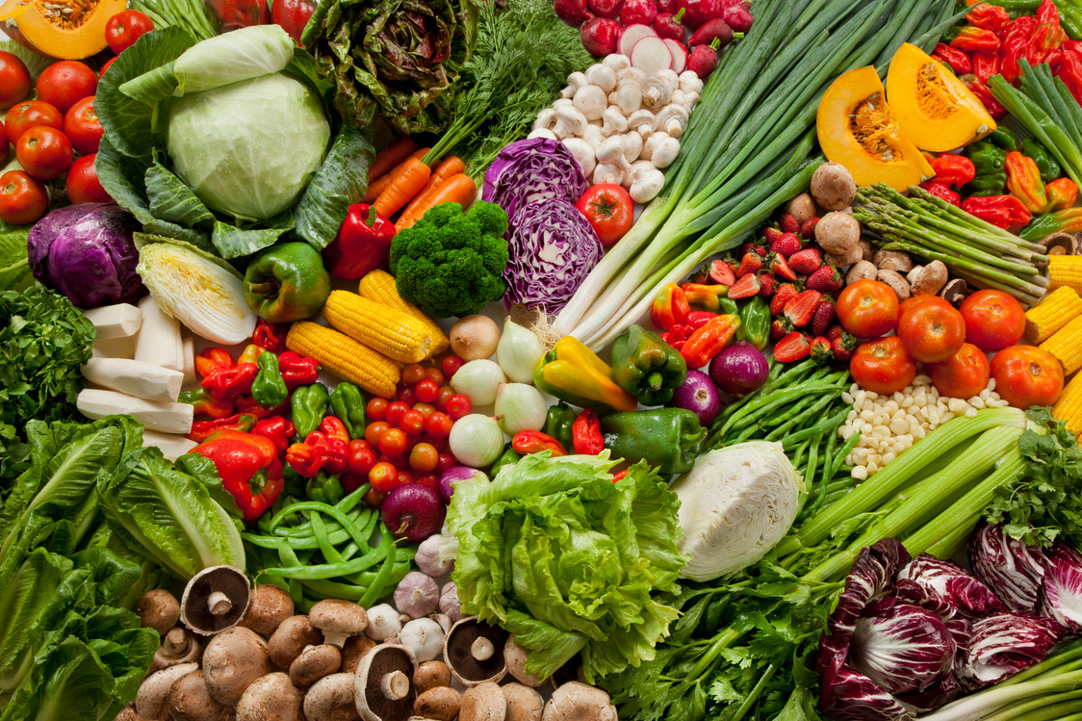
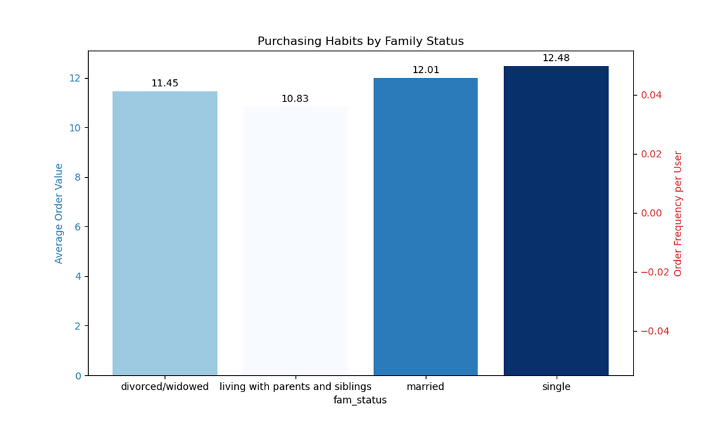
What are the purchasing habits of customers by family status?
People living independently tend to have the highest average order value, whereas those residing with parents and siblings typically have the lowest.

Slide 11
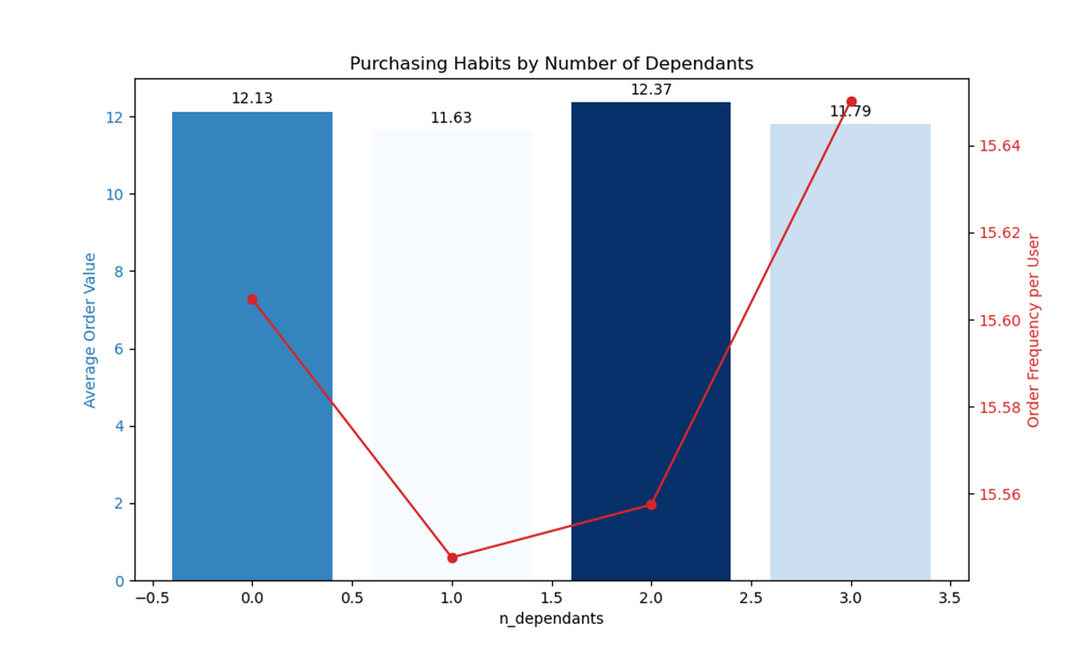

Purchasing habits of customers by number of dependants.
The average order value decreases as the number of dependents increases, but the order frequency per user shows an opposite trend, increasing with more dependents. This could indicate that while households with more dependents place orders more frequently, the value of each order is lower.

Slide 12
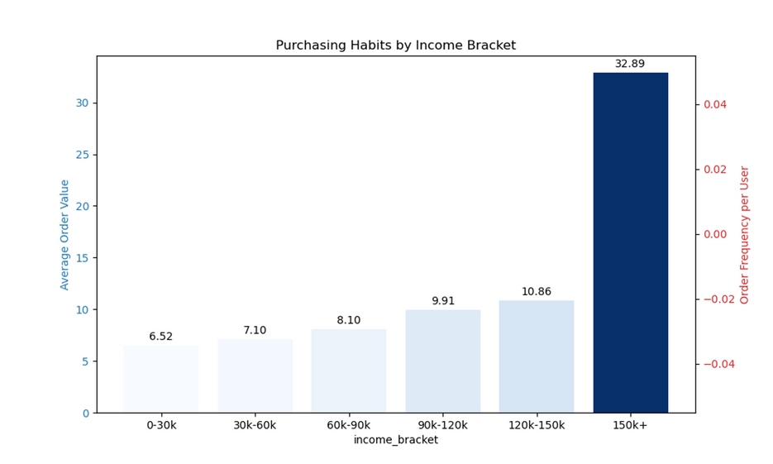

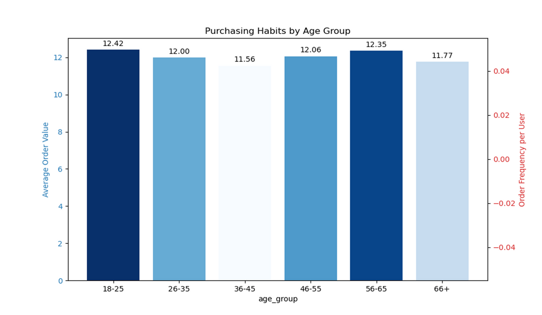

Purchasing habits by Income
The average order value escalates with income level, with individuals in the highest income bracket (150k+) having the greatest order value.
The average order value remains relatively stable across various age groups, with a slight decline observed in the oldest age group (66+).

Slide 13
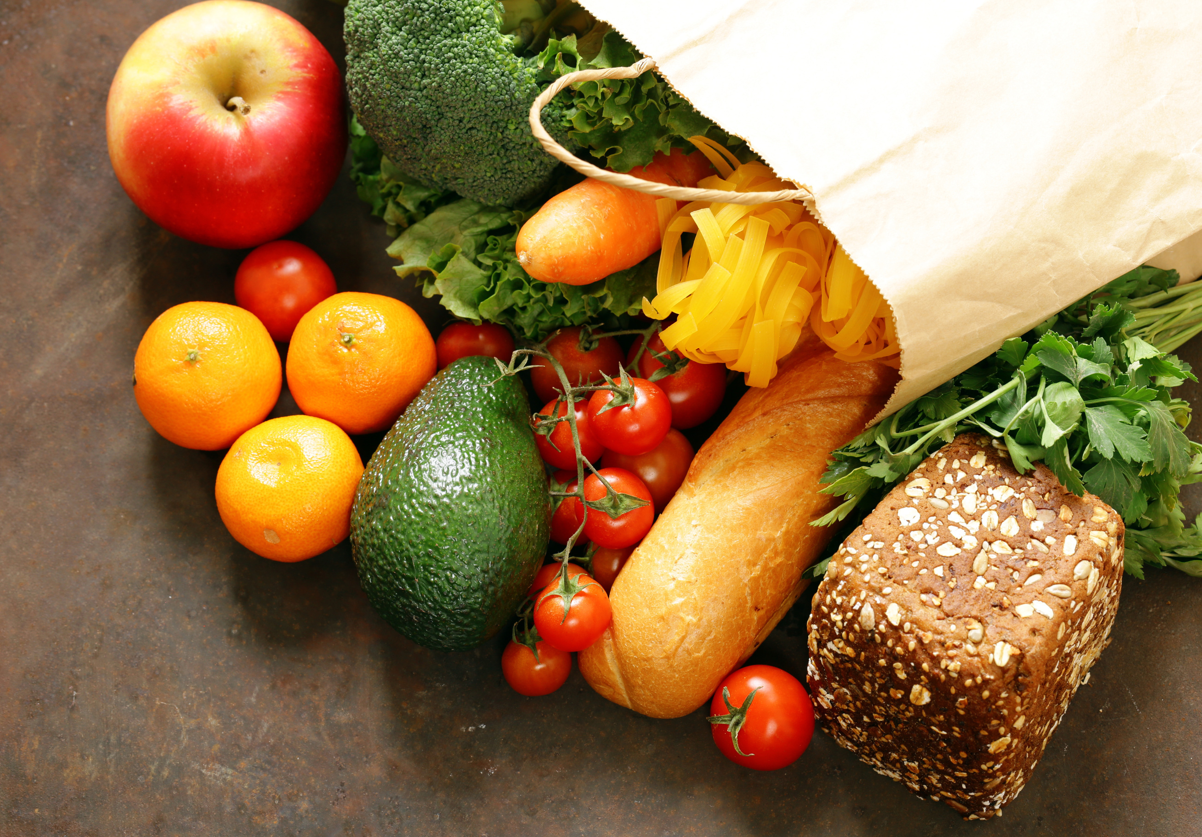



Thank you
Analysis
Visualizations
My Github

